Slide 1
Cloud Computing and Mobile Apps
CITS5503
Week 12
Dr Anwarul Patwary

Slide 2
Mobile apps
Mobile applications are normally written as:
Native applications (Swift/Objective-c for iOS and Java for Android)
Using a cross-platform language: Xamarin, PhoneGap, Flutter
Hybrid native + Html 5/CSS3
All apps rely on server infrastructure to:
User management and login
State persistence
Communication (Push notifications, email, etc)
Business logic
Decision of what to put on the client vs server determined by many factors

Slide 3
Creating an iOS App with AWS Mobile Hub
Mobile Hub provides a centralised facility to configure a mobile application that uses:
User creation, verification and then authentication
Access to DynamoDB directly (Note: there may be reasons you don’t want to do this)
Communication strategies with app users including Push Notifications
Analytics to track usage of apps
Chatbot integration
User data storage
File storage and streaming

Slide 4
Create Mobile Hub App
Create a Mobile Hub App giving name and platform
This provides by default analytics (AWS Pinpoint)
Generates a JSON configuration file with services, ids and region information
Demo app in tutorial https://docs.aws.amazon.com/aws-mobile/latest/developerguide/tutorial-ios-aws-mobile-notes-setup.html
Apps can be written for Android, React Native, React.js, others

Slide 5
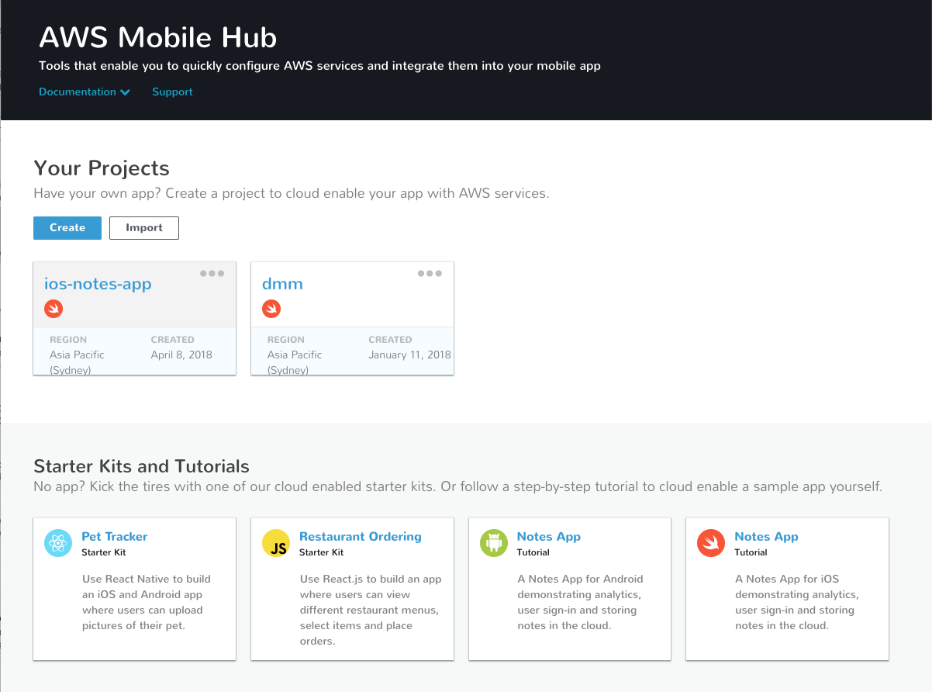

Slide 6
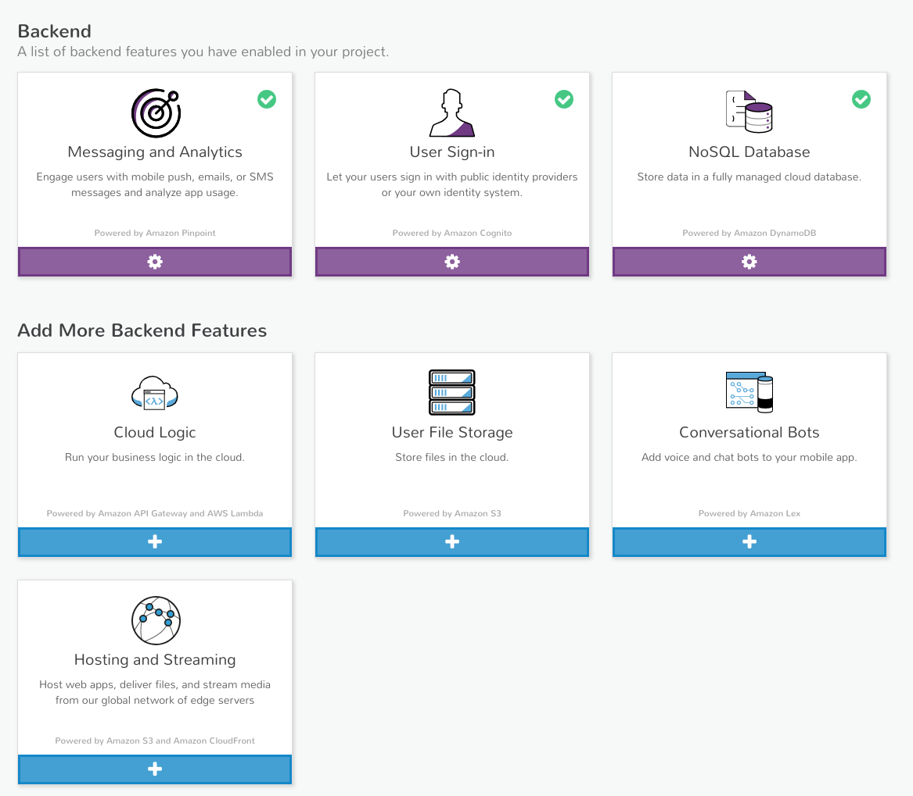

Slide 7
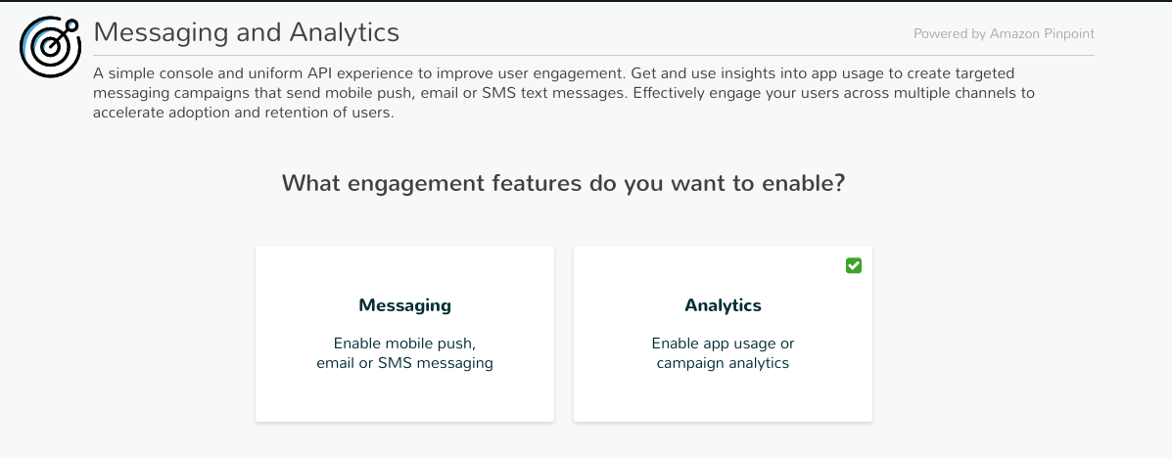

Slide 8
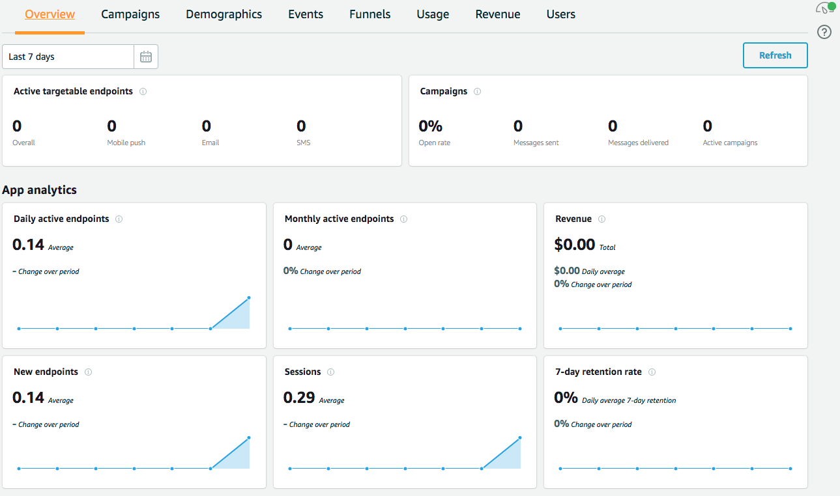
Pinpoint
// Initialisation
pinpoint = AWSPinpoint(configuration:
AWSPinpointConfiguration.defaultPinpointConfiguration(launchOptions: launchOptions))
This is all you need for user counts

Slide 9
Custom events
Track usage – normally of functions used
Can send an event when new note added and when deleted
func sendNoteEvent(noteId: String, eventType: String) {
let pinpointClient = AWSPinpoint(configuration:
AWSPinpointConfiguration.defaultPinpointConfiguration(launchOptions: nil))
let pinpointAnalyticsClient = pinpointClient.analyticsClient
let event = pinpointAnalyticsClient.createEvent(withEventType: eventType)
event.addAttribute("NoteId", forKey: noteId)
pinpointAnalyticsClient.record(event)
pinpointAnalyticsClient.submitEvents()
}
enum noteEventType: String { case AddNote = "AddNote" case DeleteNote = "DeleteNote" }

Slide 10
Custom events
Sending a new note/delete note event
// send add note event
sendNoteEvent(noteId: newNoteId, eventType: noteEventType.AddNote.rawValue)
// send delete note event
sendNoteEvent(noteId: newNoteId, eventType: noteEventType.DeleteNote.rawValue)

Slide 11
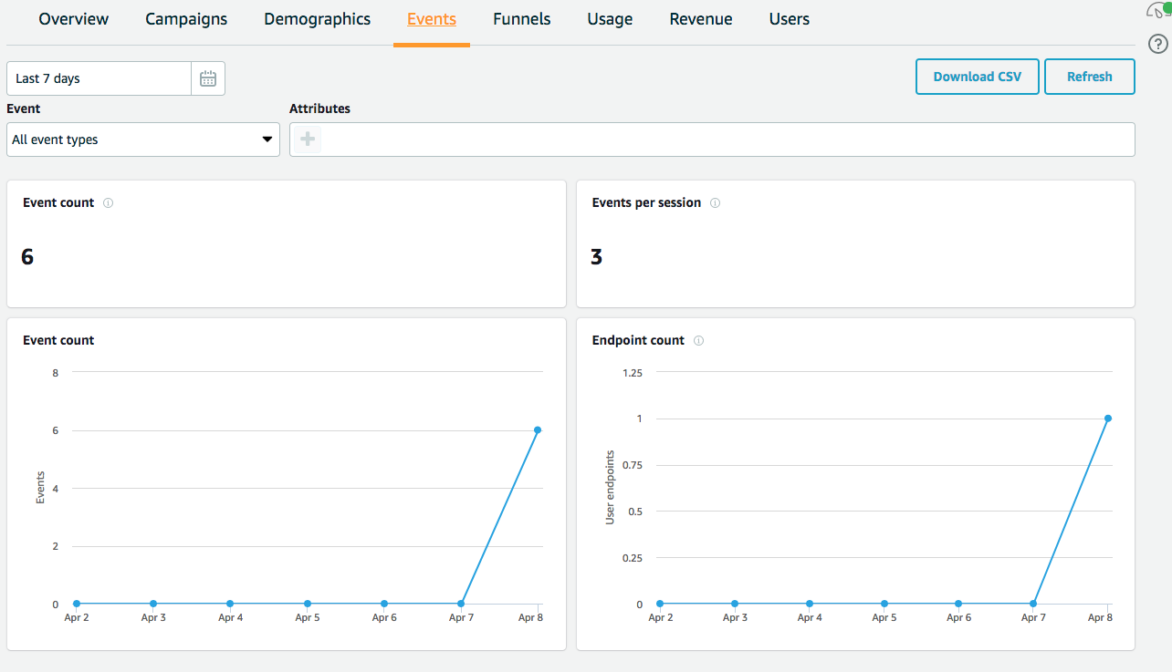
Tracking events in Pinpoint

Slide 12
Other things you can do
Funnels
Allows you to track how many users complete a certain series of events
Revenue
Summary of “monetization events” app sends
Demographics
Details of the platforms, phones, OSs etc

Slide 13
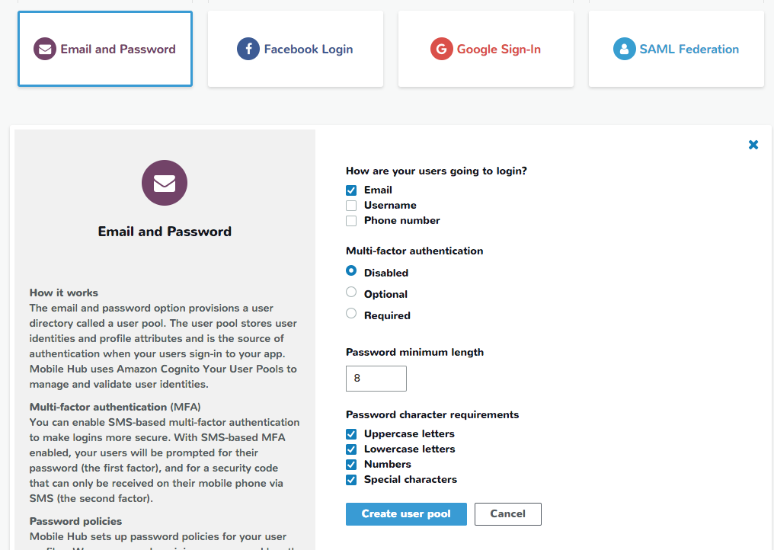
User login
Login using
Email and password
Facebook
Google
SAML Federation
Specify options for logins
Creates a Cognito User Pool
Account confirmation optional

Slide 14
Code for User Auth
//Instantiate the AWSMobileClient
func application(_ application: UIApplication, open url: URL, sourceApplication: String?, annotation: Any) -> Bool {
return AWSMobileClient.sharedInstance().interceptApplication(application, open: url,
sourceApplication: sourceApplication,
annotation: annotation)
}
// Initialize AWSMobileClient
let didFinishLaunching = AWSMobileClient.sharedInstance().interceptApplication(
application, didFinishLaunchingWithOptions: launchOptions)

Slide 15
UI for user auth
// Instantiate sign-in UI from the SDK library
if !AWSSignInManager.sharedInstance().isLoggedIn {
AWSAuthUIViewController .presentViewController(with: self.navigationController!,
configuration: nil, completionHandler: {
(provider: AWSSignInProvider, error: Error?) in if error != nil {
print("Error occurred: \(String(describing: error))”
)
} else { // Sign in successful. } }) }

Slide 16
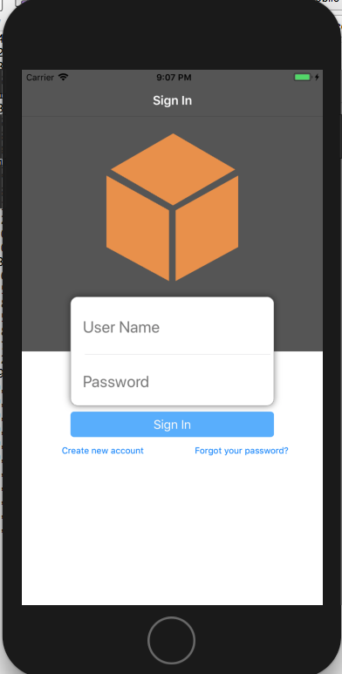
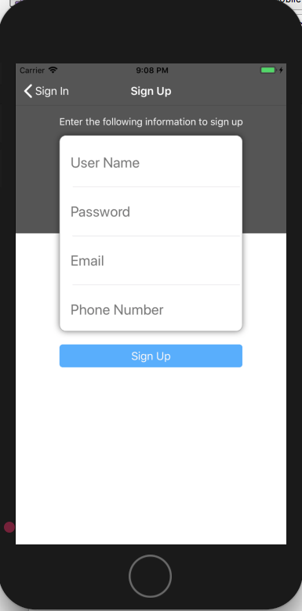
Auth UI

Slide 17

AWS Cognito
User Pools allow you to manage user account lifecycle
Provides configuration and UI for mobile and web apps
Uses an Identity Pool to associate identities and roles with a user giving them access to certain resources
Can set this up for Unauthenticated as well as Authenticated users
Can monitor logins and other attributes of users
Alternatives to AWS Cognito are managing user authentication through application
Gives single sign on capabilities

Slide 18
